Slide 1
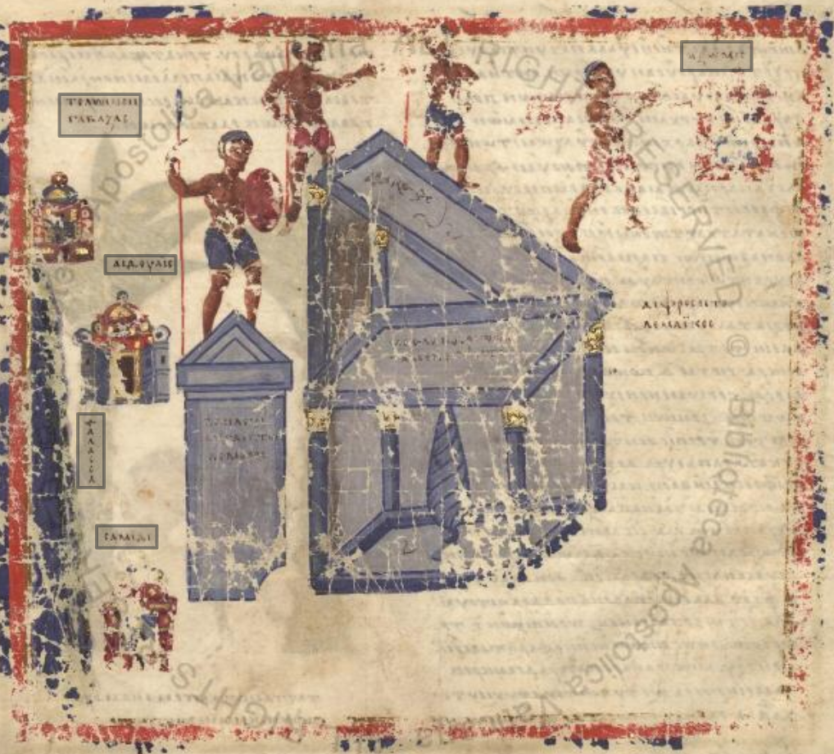
EDAK and Comparative
Digital Epigraphy
The itinerary to Aksum showing the ptolemaic inscriptions at Adulis depicted in Vat.Gr.699 f.15v (Topographia Christiana by Cosmas) annotated in Recogito
Zadar 15.12.2018

Slide 2
"If you think the 19th century was bad, try living in the 20th"
Joshua D. Sosin 2015 Balisage Symposium
(About the Integrating Digital Epigraphies project and the challenges it faced.)
→ 21st is/must be better!

Slide 3
‘Papyri and ostraca from Roman Egypt survive in sufficient numbers to invite statistical analysis and thus to teach us something out of the numbers themselves that is not evident in the body of any single text.’
MacMullen 1982, 234

Slide 4
Small/narrow defined corpora of inscriptions should be
"plunged again into the sea of all inscriptions”
Roueché and Sotinel (2017)

Slide 5
If we have multiple datasets which we can compare we can learn something out of comparing the numbers that is not evident from a single set of numbers

Slide 6
We can make a sea of inscriptions to plunge others in and potentially also plunge this into the sea of all written artefacts (coins, manuscripts, papyri etc.)

Slide 7
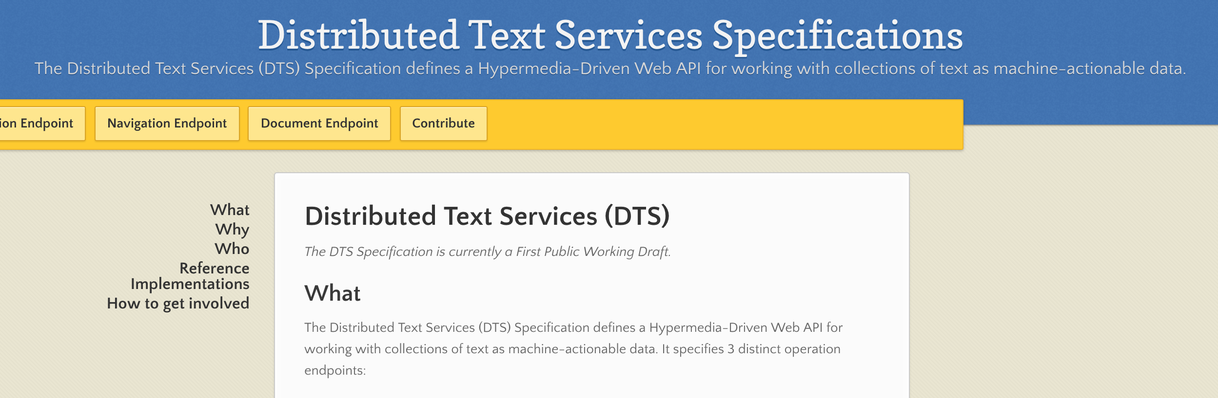
Distributed Text Services (DTS)
w3id.org/dts

Slide 8
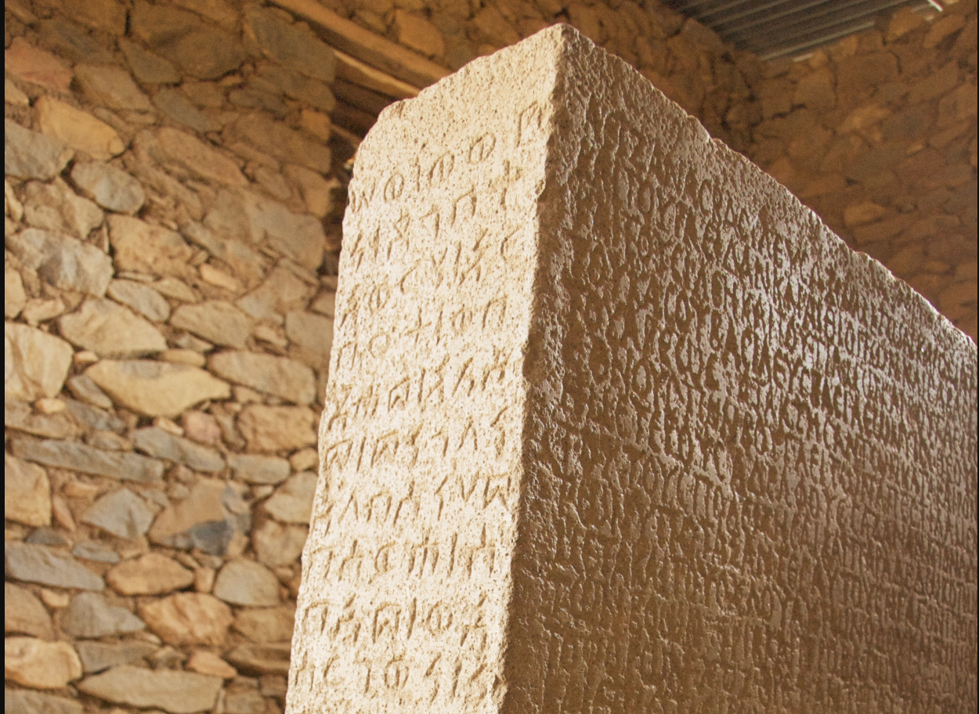
Experiment: Contextualize the Ethiopic Inscriptions
113 Inscriptions in Classical Ethiopic, Greek dated between 300 and 700 CE
Compared with the contemporary epigraphic documentation EXCLUDING SOUTH ARABIA!

Slide 9
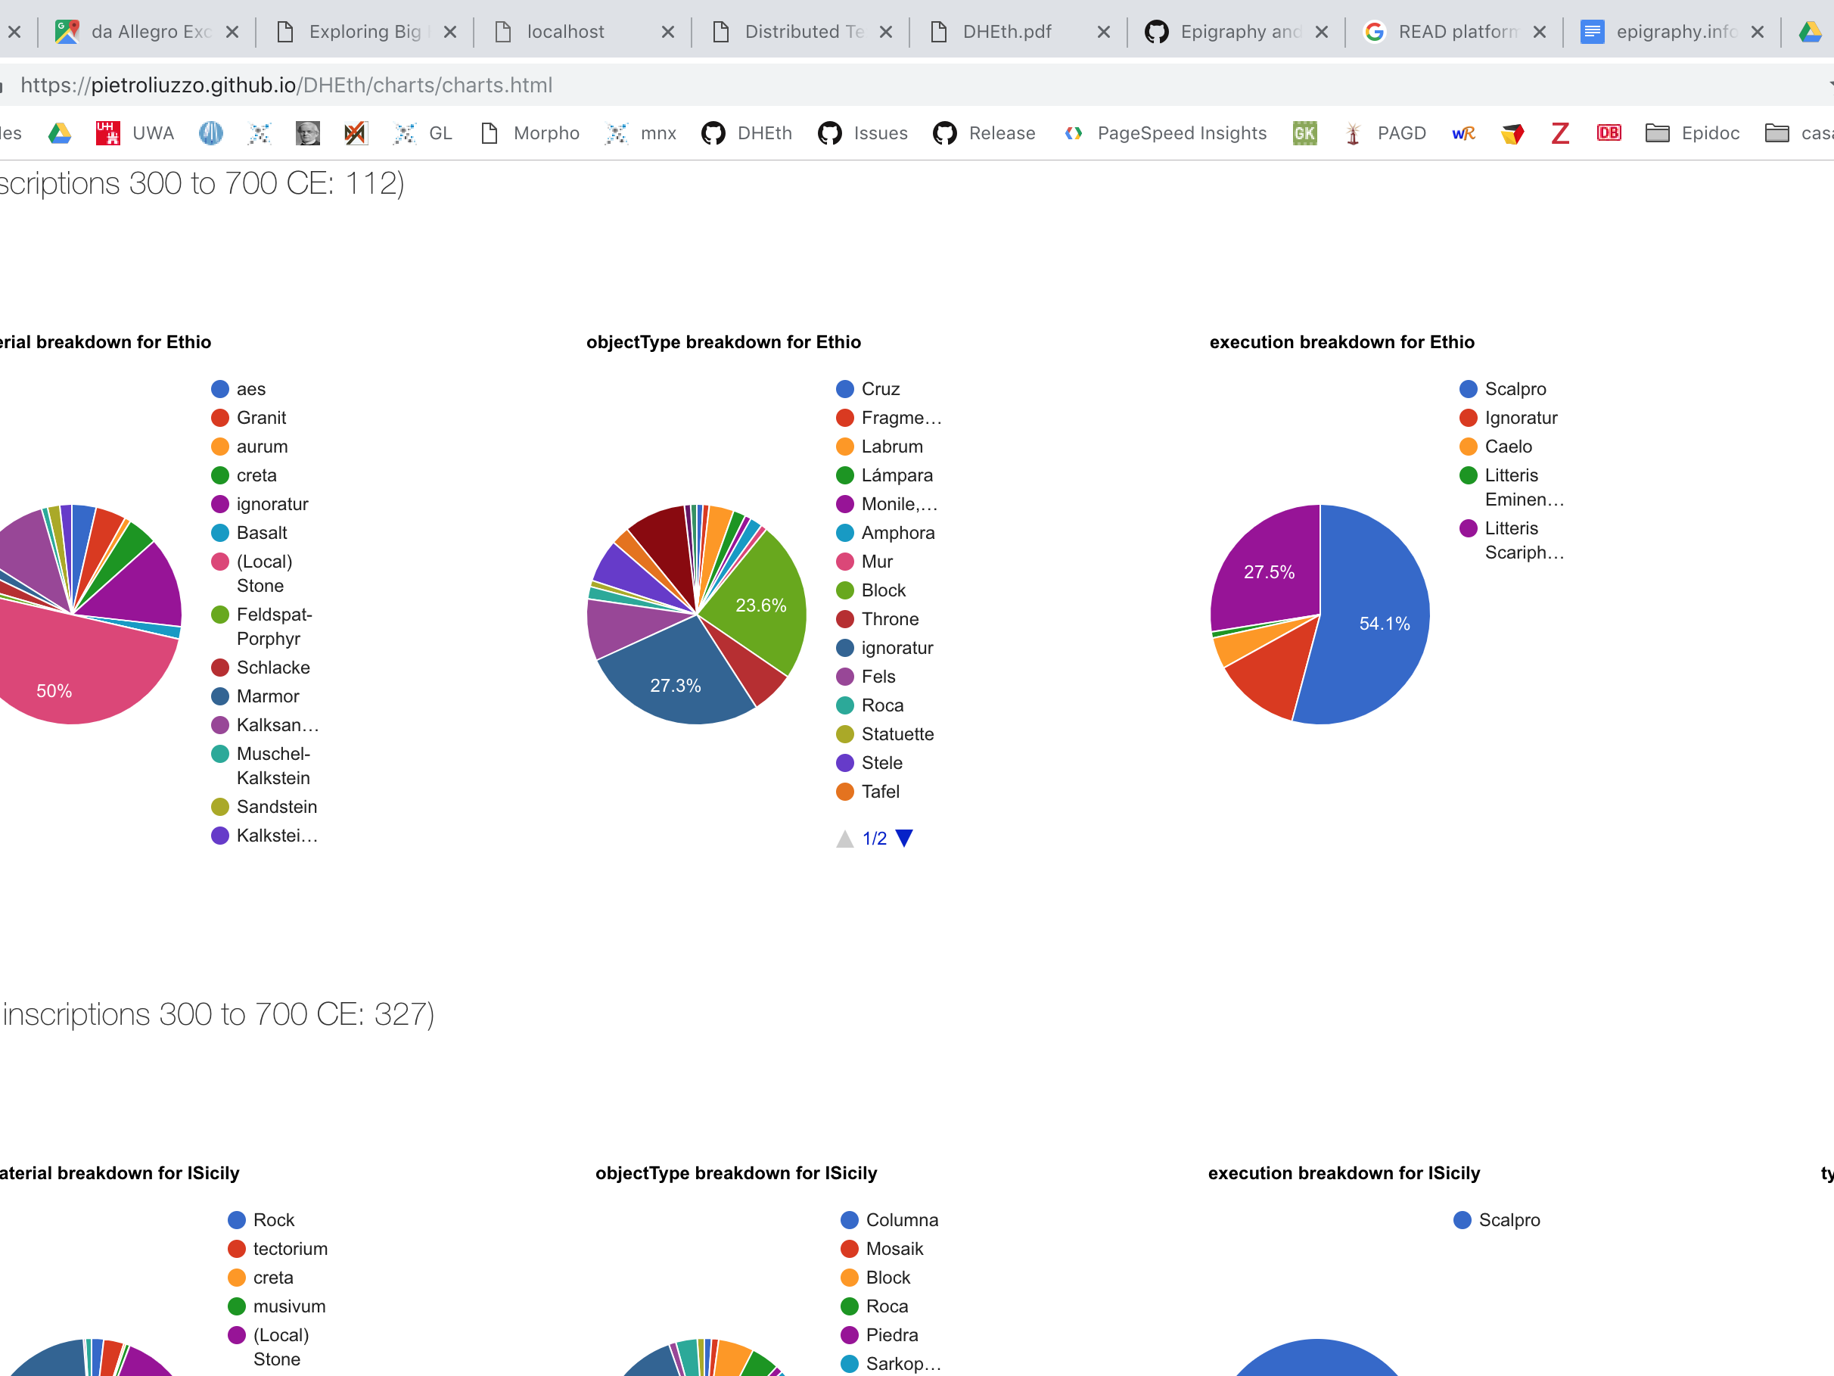
48 of these charts X 4
Compare Aksumite inscriptions
based on typology to subsets dated 0300 to 0700 from:
EAGLE, ISicily, Trismegistos inscriptions from Egypt, breaking down EAGLE data by content provider

Slide 10
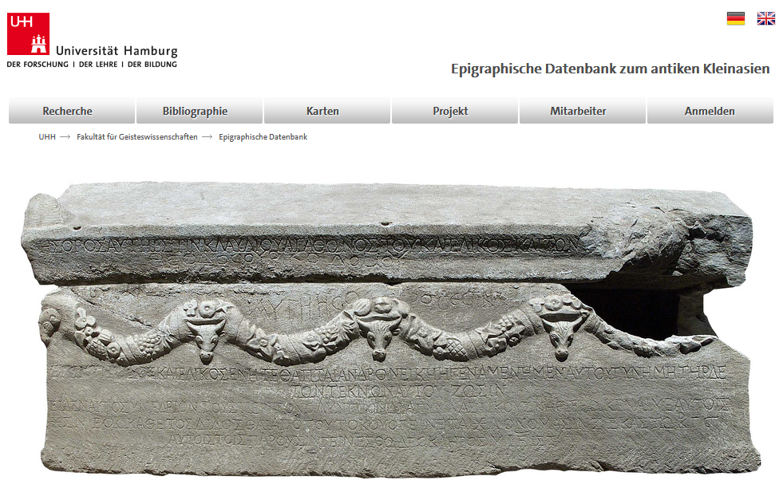

Slide 11
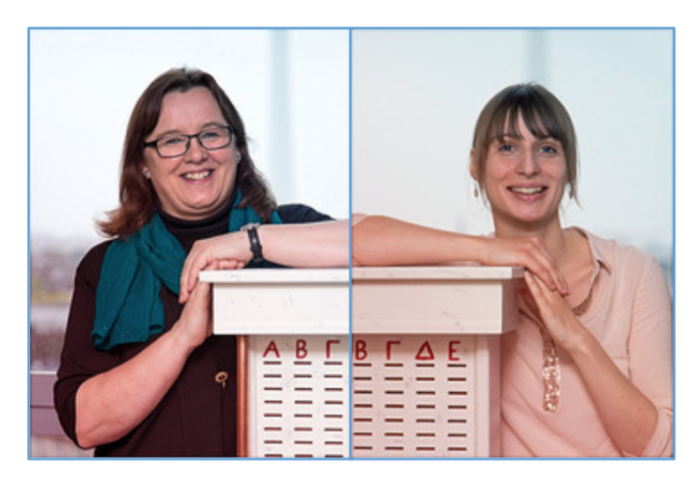

Slide 12
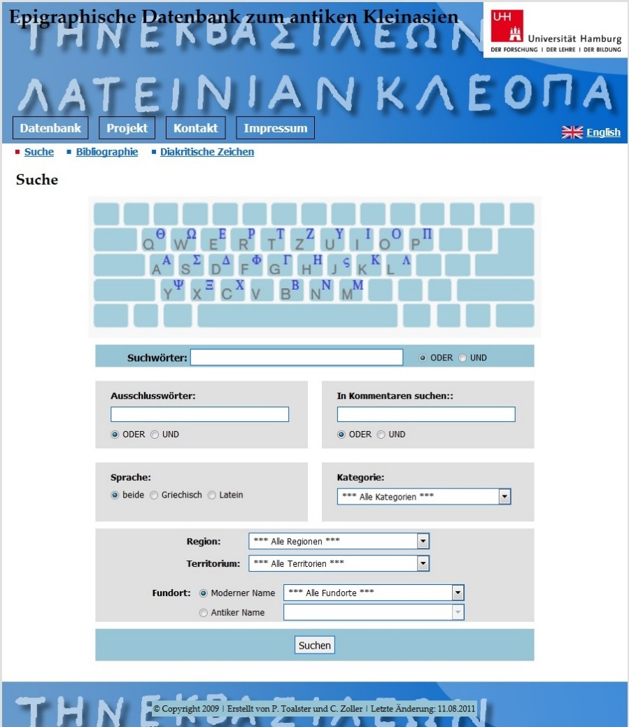
History
Start 1993
About 6000 inscriptions from Lydia, Ephesos and Galatia with commentary and find spot (google maps)
  MySQL database

Slide 13
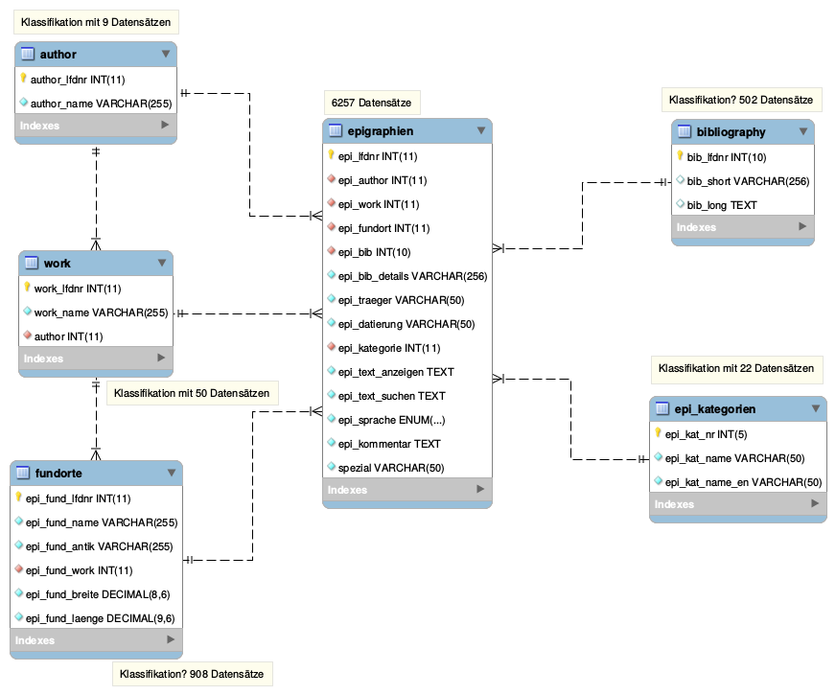
  PHP application with MySQL (MyISAM) connection
  No referential integrity (foreign key without link, inconsistent data set)
  Workload of data manage-ment increases with num-ber of data sets
  Remodelling due to the „Nachhaltigkeitsstrategien“ of UHH in 2015

Slide 14
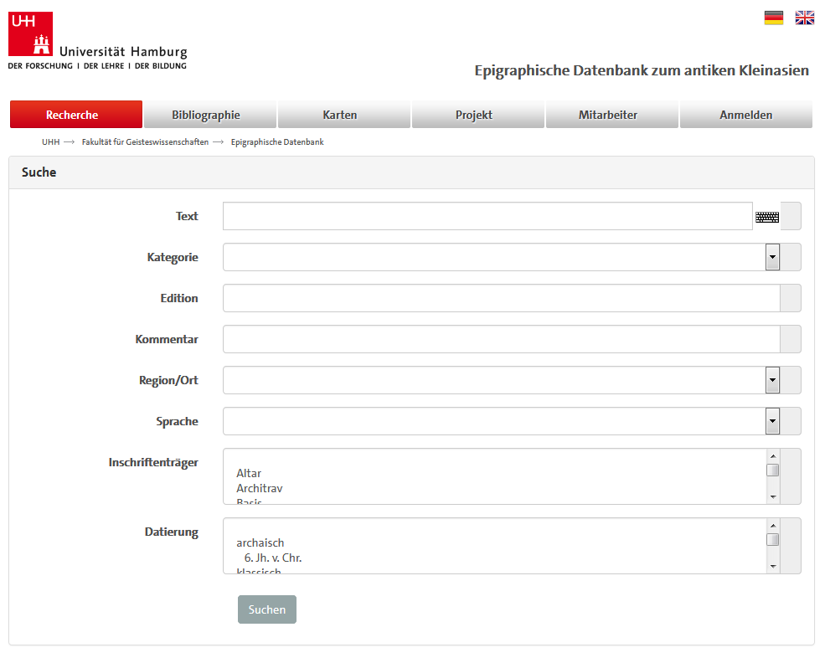
Improvement
Corporate design
New search options
(date, object type)
Images
German translations
Sustainable data format
-> XML and MyCoRe frame-
work

Slide 15
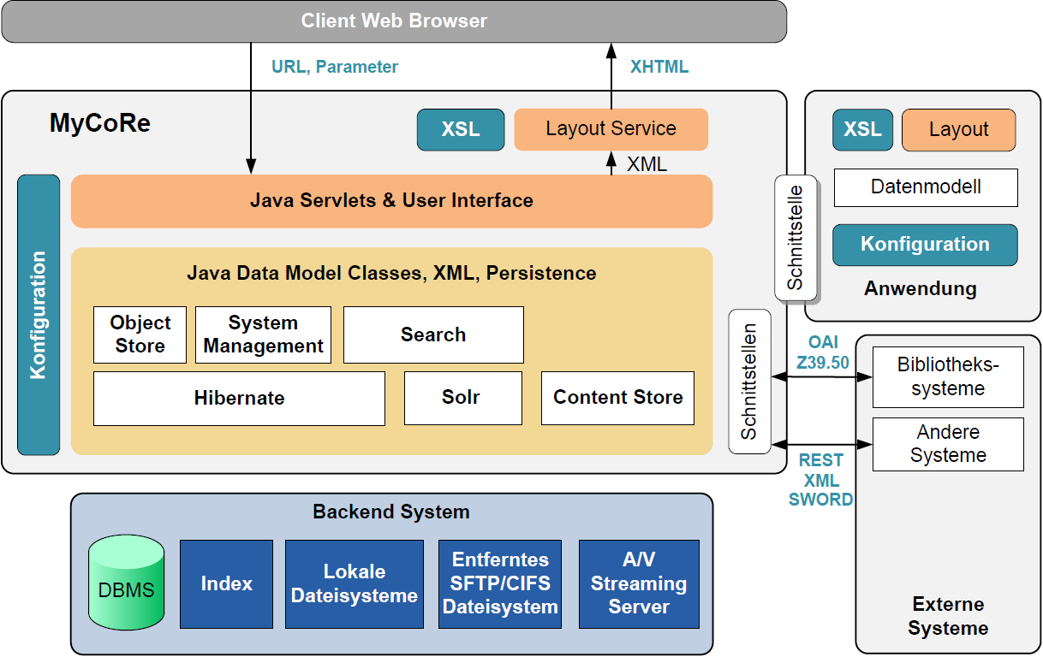
MyCoRe Framework

Slide 16
Conclusion
☺
☹
Minimal data management and server support
Quick and flexible search
Data in XML
Derivate upload possible
No access to the hard-coded parts
No technical support
No epidoc, no linked data
Data modelling restricted by MyCoRe functions
Rudimentary user administration
Bugs and dysfunctions of the WCMS

Slide 17
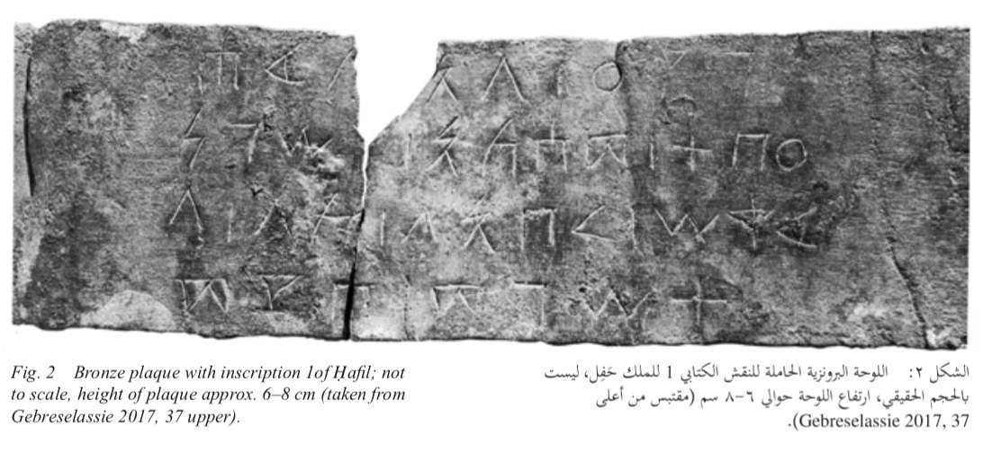
Comparative Digital
Epigraphy
No good news
as of
15.12.2018!!

Slide 18
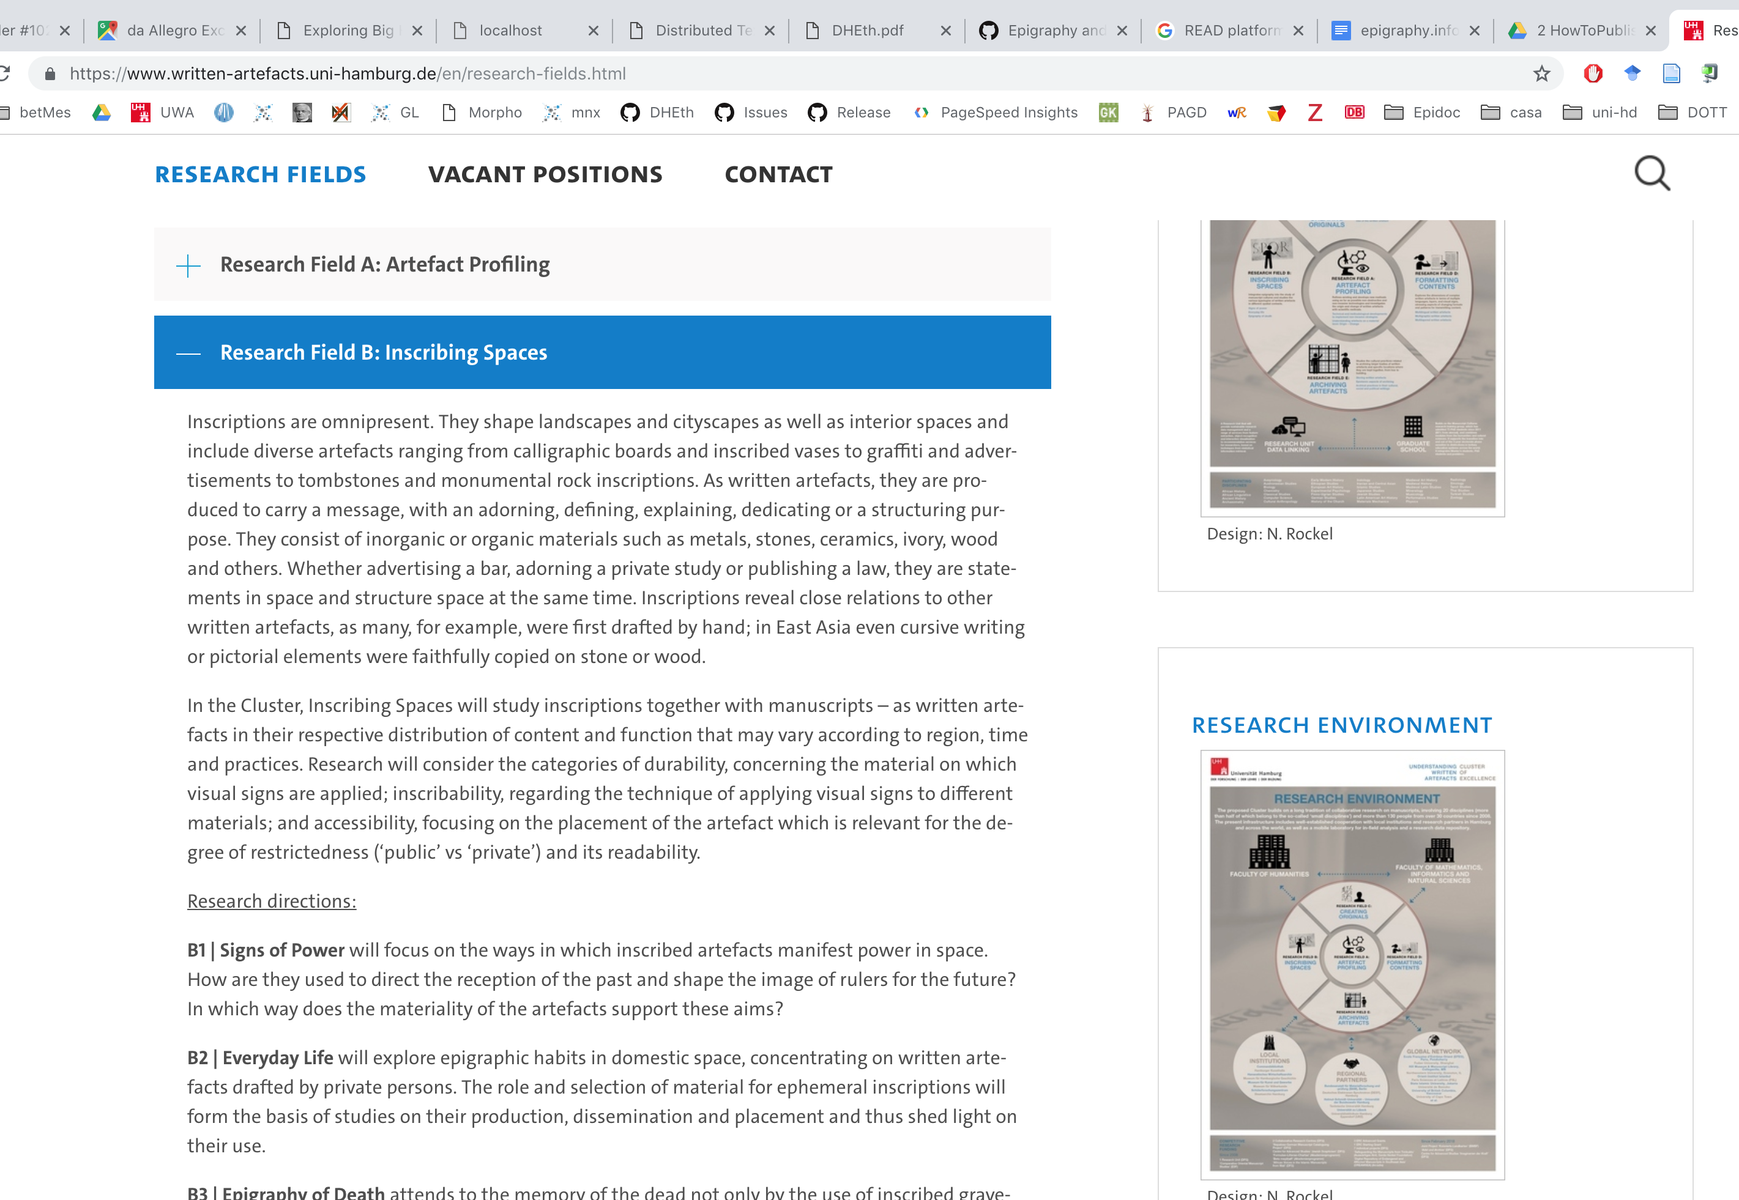
THERE WILL BE ANOTHER CALL IN SPRING: APPLY!

Slide 19
Comparative Digital Epigraphy main aims
Compare EpiDoc data of diverse provenance based on typologies (and image similarity?)
Contribute towards an epigraphic ontology for the cross-cultural comparison of epigraphic data
Analysis on the basis of typological features only
Update of The EAGLE vocabularies
Use the data for analysis, not producing new data if not for the curation of three datasets: EDAK, RIE and potentially a third oriental language

Slide 20

Demo Model 5 / Distributed approach using DTS
Just use your imagination
EpInfo
Primarily for Scenario 1, for mortals
OEDUc
Serves Scenarios 2
and 3
EDAK
Primarily for Scenario 4
A generic mash up
Aggregator.
Primarily for Scenario 4,
A new/relaunching project
BetMas
Primarily for Scenario 2
These actually exist
A Running project. Also exemplifies mixed contents

Slide 21
Comparative Digital Epigraphy using DTS
?Ep?Info?
Just use your imagination
Semitic/ Sanscrit ???
IDEA
EAGLE Vocabularies
+ EpOnt
EDAK
Primarily for Scenario 4
EAGLE
Primarily for Scenario 4,
A new/relaunching project
These actually exist
BetMas
Primarily for Scenario 2
Vocabulary editor
Perseids
A Running project. Also exemplifies mixed contents

Slide 22
Comparative Digital Epigraphy
Networking existing available data and reusing it for analysis with an ontology based on CRMtext and EAGLE CIDOC-CRM
Recontextualizing isolated datasets
Looking at continuities and discontinuities in the epigraphic production from a distant perspective
Explore and identify new questions on written artefacts based on typologies and relations including manuscripts, coins, papyri, etc. testing if breaking the distinctions takes anywhere.
Prototyping based on DTS exchanges and RDF serializations of cross-corpus research questions and evaluation of visualization technologies

Slide 23
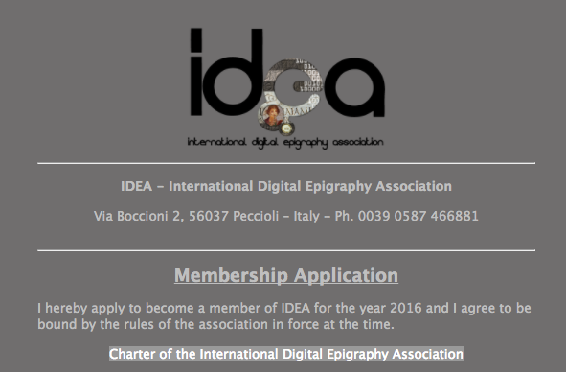
Thank you very much
Pietro Maria Liuzzo
pietro.liuzzo@uni-hamburg.de
Universität Hamburg
IDEA, International Digital Epigraphy Association
https://form.jotformeu.com/61524210874350
References
You can find all images of inscriptions in this presentations searching “EUROPA” in the EAGLE portal https://www.eagle-network.eu/basic-search/

